Slide 1
Face Recognition

Slide 2
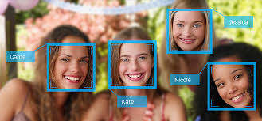
Face recognition
Face recognition is a concept of identifying or verifying a person from a image or a video frame from a video.

Slide 3
How do they work?
Face recognition systems work by comparing the facial features between a test image and images from a database.
These facial features are extracted from deep neural networks.
By training a face recognizer, the algorithm is learning to extract important facial features that help in the recognition task.

Slide 4
Recognition task
We will get single image as input and we have to recognise if that image is known to us/system (present in the database) or not.
To train deep neural networks to recognize individuals, we need huge amount of data.
Usually, the database will only have single images of individuals. This makes it difficult to train traditional neural network architectures.

Slide 5
One-shot learning
One shot learning is a object categorization problem where instead of training deep learning models with a very large training set, we train the models from one or only a few examples for each class.
Face recognition actually requires us to solve the one-shot learning problem

Slide 6
Learning the similarity function
We want the network to learn a function ‘d’ that tells the degree of difference between two images.
If any two images are similar, the function ‘d’ outputs a small value indicating the similarity. If the images are different, the function ‘d’ should output a large value indicating the two images are different.
Therefore, during inference, if the output of function ‘d’ is less than a threshold value (a), we can say the images belong to a same person.

Slide 7
The concept of making the neural network learn the similarity function solves the one-shot learning problem and is more robust. We can easily add new members to our database without changing the model flow.

Slide 8
Siamese network
A Siamese neural network is a ANN that uses the same weights while working in tandem on two different inputs to compute comparable outputs.

Slide 9
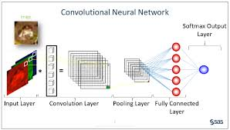

Slide 10
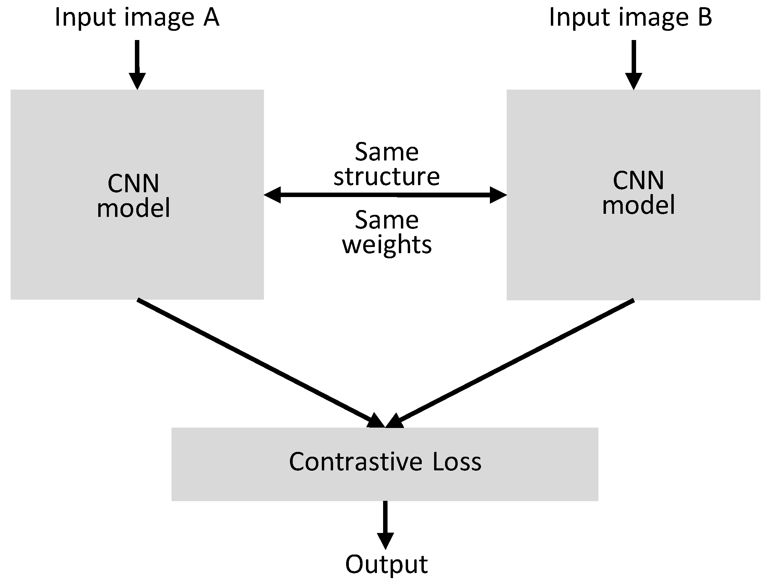

Slide 11
Training
The output encodings depend on the parameters of our network.
Learn parameters such that:
If two images are same, the similarity function outputs a small value.
If two images are different, the output is a large value.

Slide 12
Loss function
Triplet loss
Contrastive loss

Slide 13
Steps in training
Prepare the training set (Triplets)
Use the network output encodings to measure the loss.
Perform back propagation.
Use gradient descent to update the weights.
Different weights gives different encodings, repeat until we get good encodings (Low loss)

